Slide 1

QUALITY PREDICTION IN MINING PROCESS
Group id :11
Project Team:
Gade Harshith
Sai Nikhil Dunuka

Slide 2
INTRODUCTION
The mining industry is a vital sector that contributes significantly to global economic development and infrastructure. Within this sector, the efficient extraction and processing of valuable minerals are crucial for sustainable operations. However, one of the persistent challenges faced by mining plants is the presence of impurities in ore concentrates, which can impact the overall quality and purity of the final product.
This introduction emphasizes the critical role of predictive analysis in the mining industry and underscores the significance of leveraging data-driven insights for process optimization and improved impurity control in ore concentrates.

Slide 3
ABOUT THE DATASET
The dataset originates from a real-world flotation plant, crucial in the mining process.
Data ranges from March 2017 to September 2017, featuring key quality measures, process variables, and final lab measurements.
The target is to predict the % of silica in the iron ore concentrate, aiding in reducing impurities and minimizing environmental impact.

Slide 4
OBJECTIVES
Objective: Predict impurity levels in ore concentrate for proactive decision-making and process optimization.
Empowerment: Early predictions enable proactive measures, reducing impurities and optimizing the mining process.
Industry Impact: Findings and models set standards for efficiency and sustainability in the wider mining industry.
Stakeholder Benefits: Engineers, regulators, and communities benefit from improved efficiency and reduced environmental impact.

Slide 5
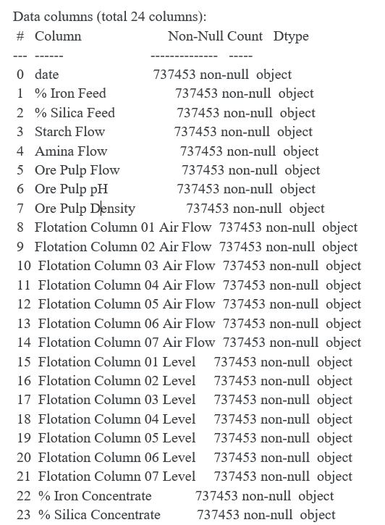
Data Columns Overview
Time and Date Range: Dataset covers March 2017 to September 2017, allowing comprehensive analysis of the mining process.
Sampling Frequencies: Data sampled every 20 seconds and hourly, providing insights into short-term and long-term trends.
Key Variables: % Iron Feed, % Silica Feed, and various parameters crucial for understanding impurity levels.
Process Data: Parameters like flotation column levels and air flow impact ore quality, contributing to the analysis.
Lab Measurements: Final lab measurements serve as reference points to validate predictive models.

Slide 6
Data Preprocessing
Importance of Data Preprocessing: Data preprocessing is crucial in preparing the dataset for analysis, as it ensures that the data is clean, consistent, and ready for further exploration. In the context of quality prediction in the mining process, data preprocessing helps in identifying and addressing data inconsistencies, missing values, and outliers, leading to more reliable analysis results and improved model performance.

Slide 7
Feature Selection
Significance of Feature Selection: Feature selection plays a critical role in identifying the most relevant variables for analysis, allowing us to focus on the essential factors that influence impurity levels in the mining process. By selecting the most impactful features, we can simplify the analysis process, improve model interpretability, and enhance the overall accuracy and performance of predictive models.

Slide 8
Code :
https://colab.research.google.com/drive/1btbcHc7bHtpc-iTGatQdl6Nqm9UCB1u5?usp=sharing

Slide 9
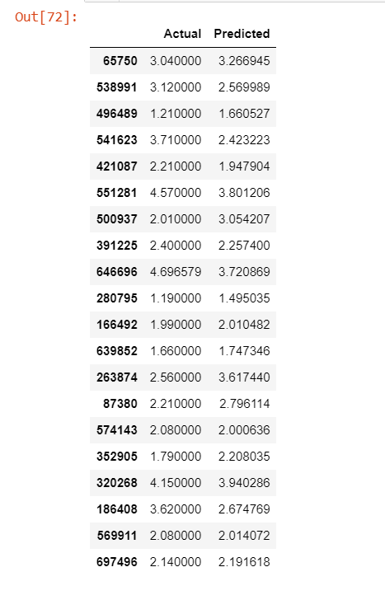
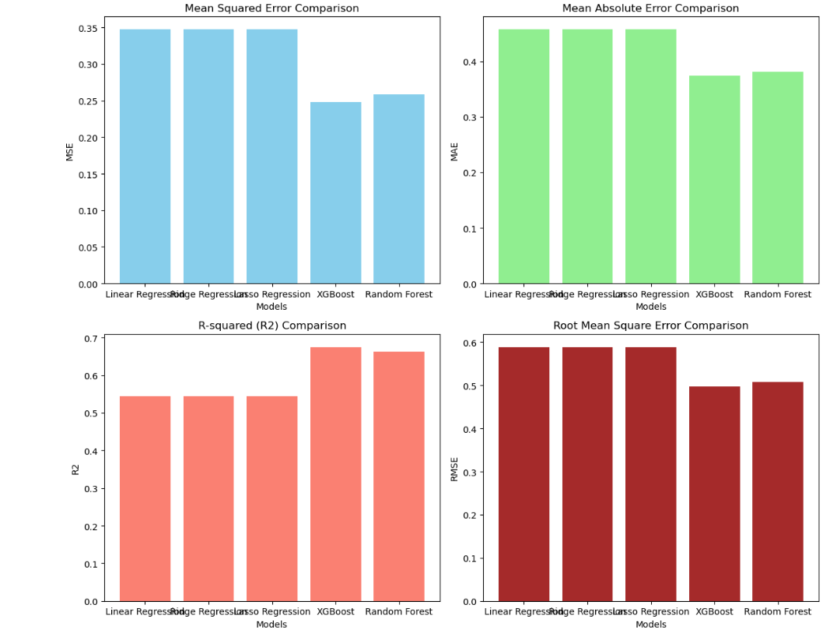
Results

Slide 10
CONCLUSION
1. Data-Driven Decision-Making: The utilization of data-driven approaches has proven instrumental in enhancing the efficiency and sustainability of the mining process. By leveraging insights derived from comprehensive data analysis, mining engineers and stakeholders can make informed decisions, implement proactive measures, and optimize resource utilization to achieve better impurity control and overall process efficiency.
2. Optimized Mining Process: Implementing data-driven strategies and predictive models allows for continuous monitoring and adjustment of the mining process. This leads to optimized resource allocation, reduced waste production, and improved overall product quality, fostering a more sustainable and responsible mining operation.
3. Reduced Environmental Impact: By focusing on proactive impurity control and process optimization, mining plants can significantly reduce their environmental footprint. The reduction in waste production and the efficient utilization of resources contribute to sustainable mining practices, ensuring a responsible approach to mineral extraction and processing.
4. Long-Term Sustainability: Emphasizing the role of data-driven decision-making in the mining industry highlights the potential for long-term sustainability and responsible resource management. By prioritizing efficient operations, reduced waste generation, and environmental conservation, mining plants can establish a sustainable framework for future operations and contribute to the global commitment to environmental stewardship.

Slide 11
Thank you

